Slide 1


Problem Solving on DFA
Session No.: 6 Course Name: Theory of Computation Course Code: R1UC428T Instructor Name: Arvind Kumar Duration: 50 mins

Slide 2

Review of the key concepts of the session #5
We learned that an DFA is defined using a 5-tuple: (Q, Σ, δ, q₀, F).
The transition function δ allows moving to single states, for every input.
Each part of the 5-tuple was explained clearly with its role in the automaton.

Slide 3
Opening: Engaging Questions

Slide 4
At the end of this session, you will be able to:
LO1: Construct DFAs for given languages
LO2: Explain how these automata accept the strings in those languages.

Slide 5
Session Outline
1 DFA.
2 Tuples of DFA.
3 Examples.
4 Summary.

Slide 6
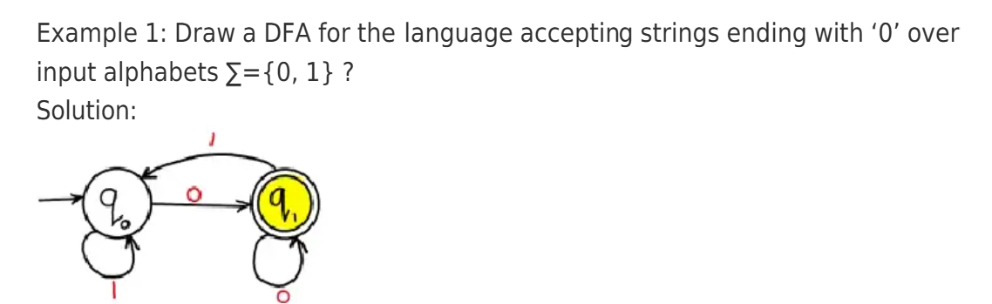
Deterministic Finite Automata
DFA (Deterministic Finite Automaton) is a type of finite automaton where, for a given state and input symbol, the machine can move to one next state.

Slide 7
Tuples of DFA
The 5-tuples of an NFA (Non-Deterministic Finite Automaton) are:
N = (Q, Σ, δ, q₀, F) where:
Q = A finite set of states
Σ = A finite input alphabet
δ = Transition function, δ: Q × Σ → Q
q₀ = Start state, where q₀ ∈ Q
F = Set of accepting (final) states, F ⊆ Q

Slide 8
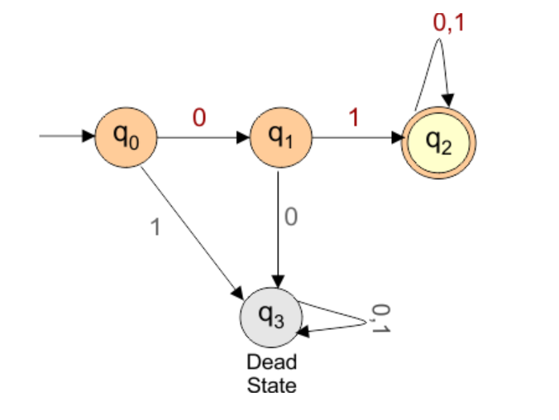
Construct a DFA that accepts all the strings over the alphabet ∑ {0,1} that start with “01”.
Transition diagram
The given question provides the following
Regular Expression = 01(0+1)*
Language of Accepted Strings = {01, 010, 011, 0100, 0111, 01101, …}
Some Rejected Strings = {ε, 0, 1, 10, 00, 11, 001, 101}

Slide 9
DFA Description
Transition Function δ is defined as:
δ(q0, 0) = q1
δ(q0, 1) = q3
δ(q1, 0) = q3
δ(q1, 1) = q2
δ(q2, 0) = q2
δ(q2, 1) = q2
δ(q3, 0) = q3
δ(q3, 1) = q3
States = {q0, q1, q2, q3}
Input Alphabet = {0, 1}
Initial State = q0
Final States = {q2}
Dead State = q3

Slide 10
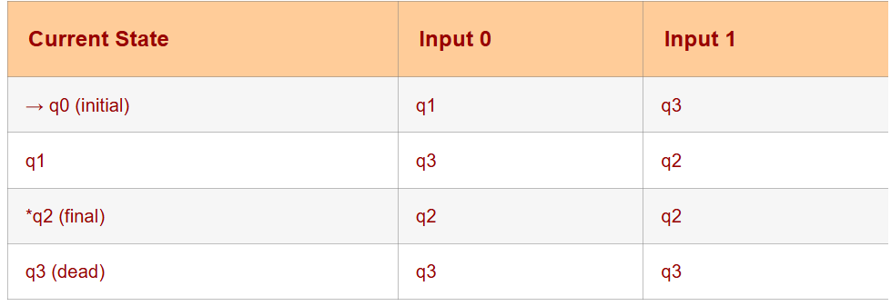
Transition Table

Slide 11
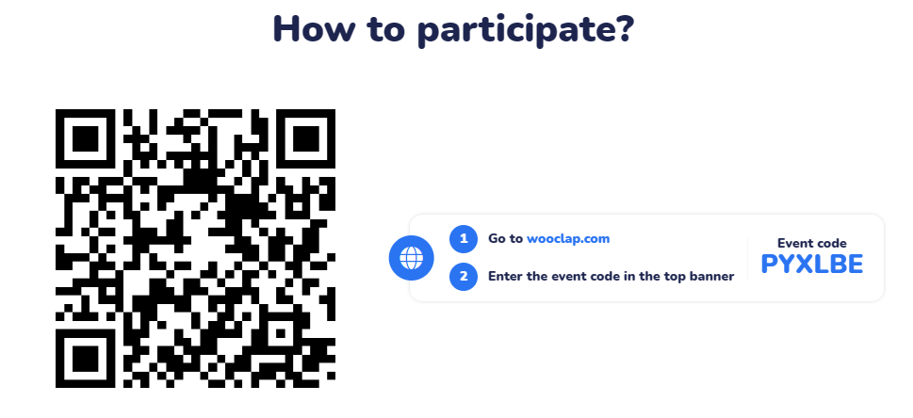
Learning Activity-1(Problem Solving)

Slide 12
Learning Activity-1(Problem Solving) (Use pen and paper)
1. DFA over input Σ (a, b) that Accepts All the Strings With
Exactly 1 ‘a’
At most 1 ‘a’
At Least 1 ‘a’
Exactly 2 ‘a’
At most 2 ‘a’
At Least 2 'a’
At Least 1 'a' and Exactly 2 b's

Slide 13
Summary
Brief introduction of DFA
Tuples of DFAs and their meanings
Construction of DFAs of various languages.

Slide 14
Ensure attainment of LOs in alignment to the learning activities:
LO1: Construct DFAs for given languages
LO2: Explain how these automata accept the strings in those languages.

Slide 15
Discussion on the post session activities
Attempt the Post-Session-6 Quiz on LMS.

Slide 16
Information about the next lesson
Revision / Tutorial

Slide 17
Feedback and Queries

Slide 18


